Slide 1
MY JOURNAL TO PYTHON
NAME: JAMES RYAN PREGON
TEACHER: MY DEAR GREAT TEACHER

Slide 2
AGENDA
Python
Input and output: input() and print()
Data types:
Operators ON data type:
CONTROLS : IF- | IF –ELSIF |-F-ELSE
LOOP: FOR |WHILE | RANGE() | BREAK | CONTINUE
FUNCTION:
PARAMETERS(ARGUMETNS)
RECURSIVE FUNCTION
LAMBDA FUNCTION

Slide 3
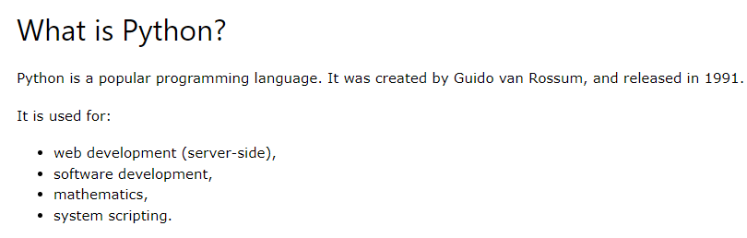
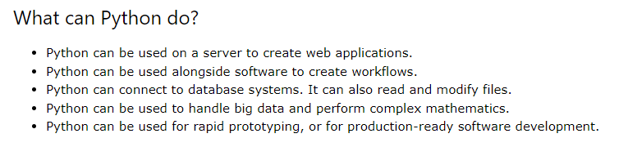
PYTHON

Slide 4
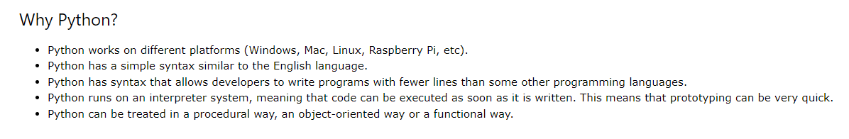
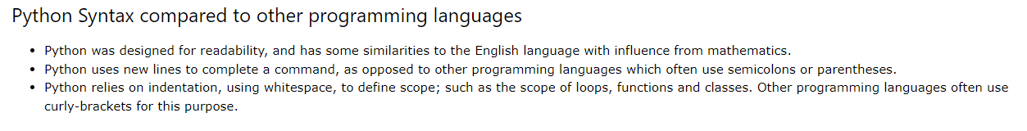
PYTHON

Slide 5


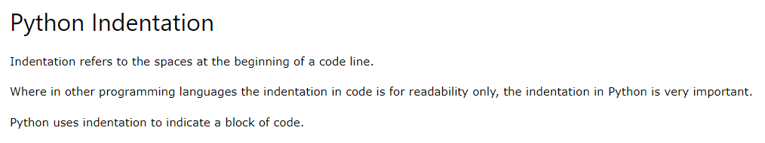


My First Program
Code and output

Slide 6
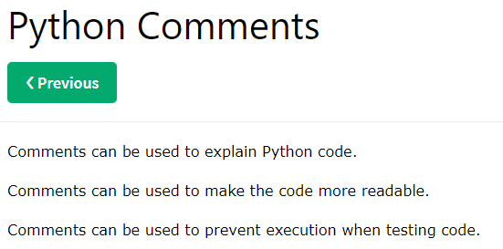
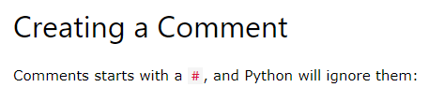


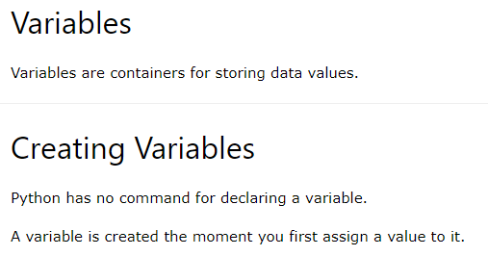
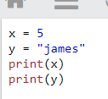

Code and output
Python Variables
Code and output

Slide 7
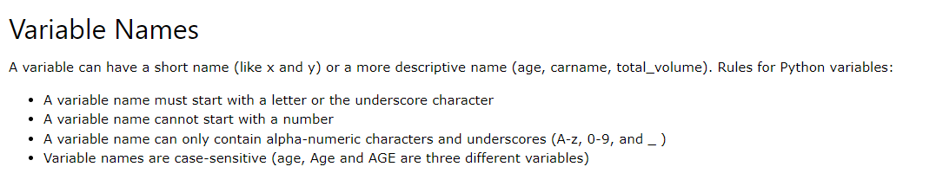
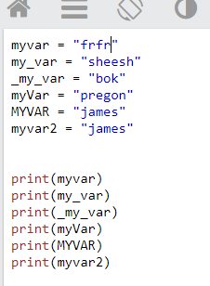
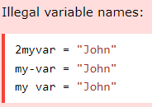
Python - Variable Names
Legal variable name

Slide 8


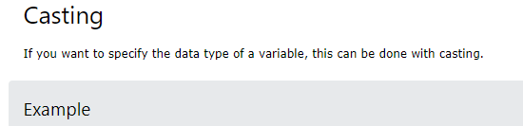
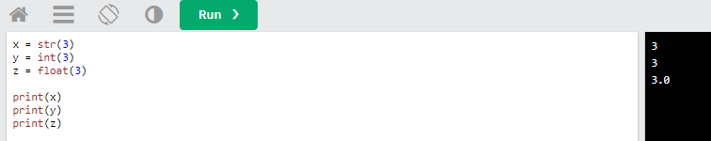
Python - Variable Names

Slide 9
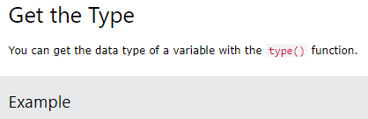
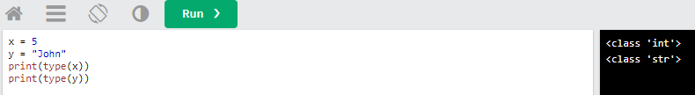
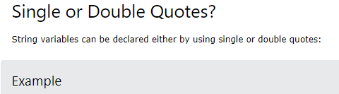
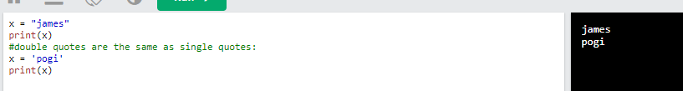
Python - Variable Names

Slide 10
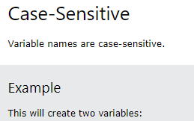
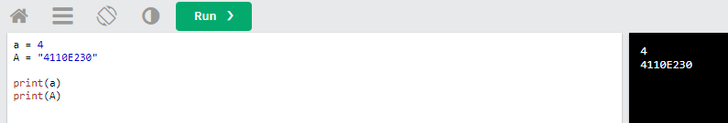
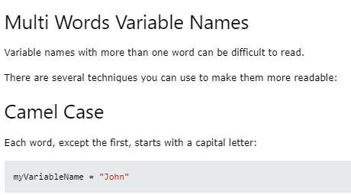
Python - Variable Names

Slide 11
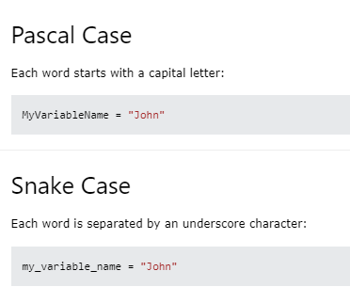
Python - Variable Names

Slide 12
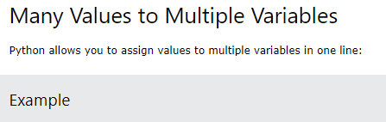
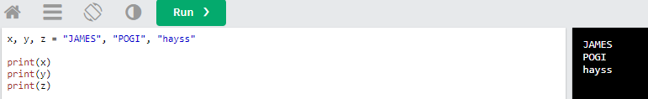
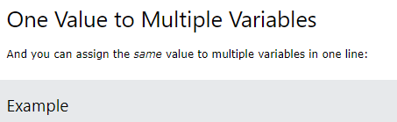
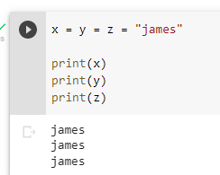
Python - Assign Multiple Values

Slide 13
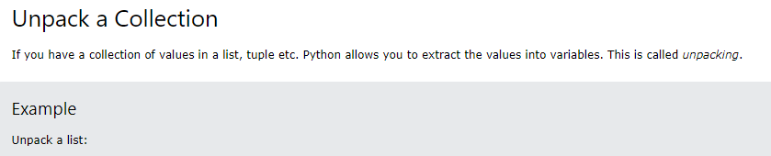
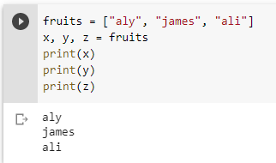
Python - Assign Multiple Values

Slide 14
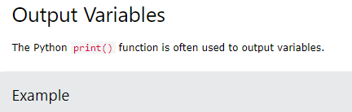
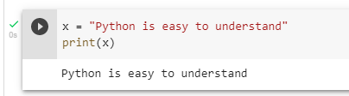
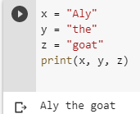
Python - Output Variables

Slide 15


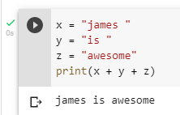
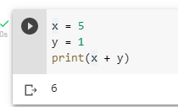
Python - Output Variables

Slide 16

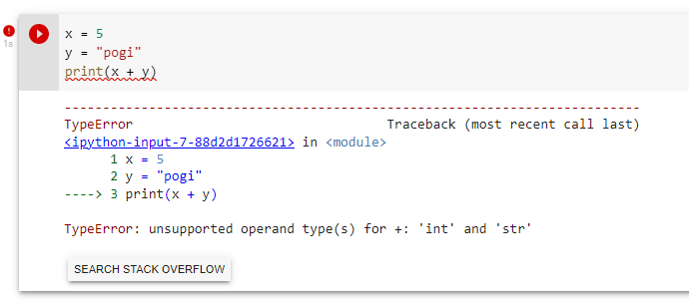
Python - Output Variables

Slide 17
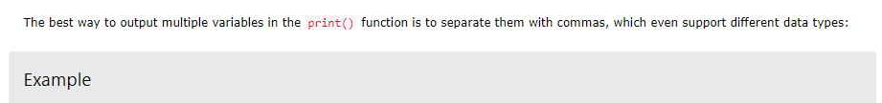
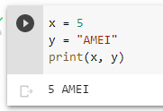
Python - Output Variables

Slide 18
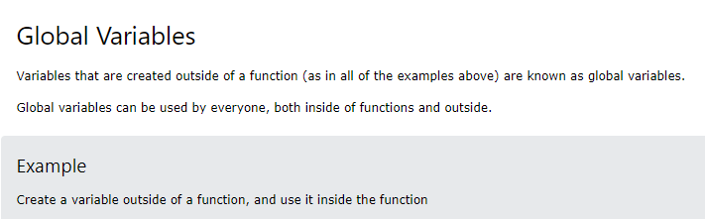
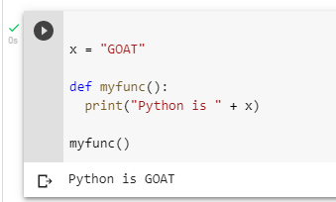
Python - Global Variables

Slide 19
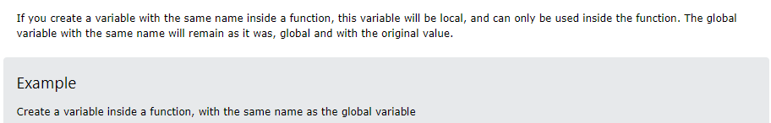
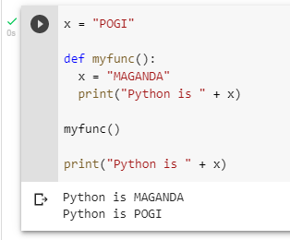
Python - Global Variables

Slide 20
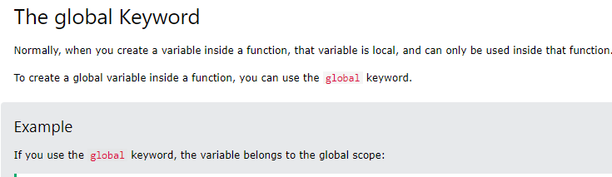
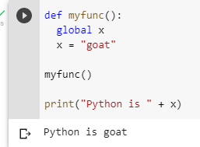
Python - Global Variables

Slide 21
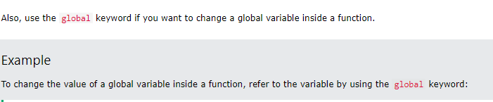
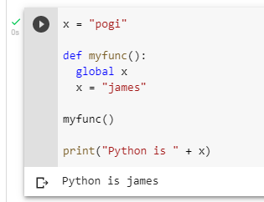
Python - Global Variables

Slide 22
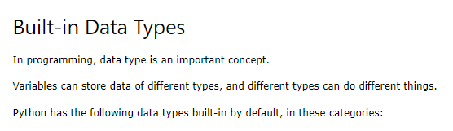
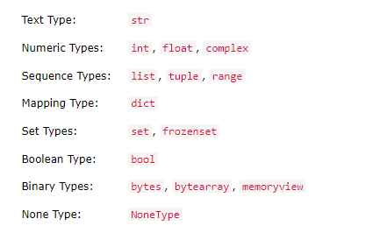
Python - Data Types

Slide 23


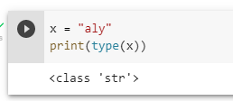
Python - Data Types

Slide 24

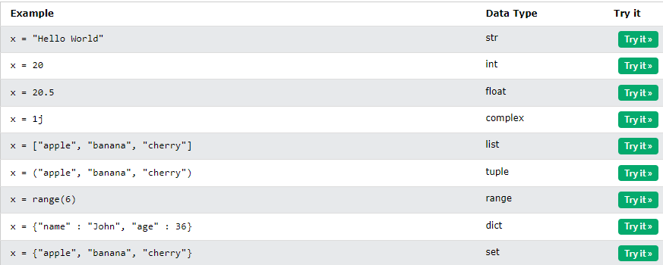
Python - Data Types

Slide 25
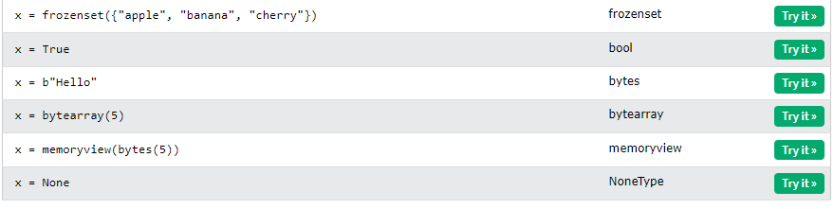
Python - Data Types

Slide 26
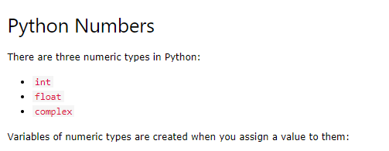

Python - Numbers

Slide 27




Python - Numbers

Slide 28




Python - Numbers

Slide 29


Python - Numbers

Slide 30


Python - Numbers

Slide 31


Python - Numbers

Slide 32

Python Casting

Slide 33


Python Casting

Slide 34

Python Casting

Slide 35

Python Casting

Slide 36


Python Strings

Slide 37


Python Strings

Slide 38


Python Strings

Slide 39


Python Strings

Slide 40


Python Strings

Slide 41


Python Strings

Slide 42


Python Strings

Slide 43



Python Strings

Slide 44


Python Strings

Slide 45


Python Strings

Slide 46


Python Strings

Slide 47


Python Strings

Slide 48


Python Strings

Slide 49

Python Strings

Slide 50

Python Strings

Slide 51

Python Strings

Slide 52


Python Strings

Slide 53


Python Strings

Slide 54


Python Strings

Slide 55


Python Strings

Slide 56


Python Strings

Slide 57

Python Strings

Slide 58

Python Strings

Slide 59


Python Strings

Slide 60


Python Booleans

Slide 61


Python Booleans

Slide 62


Python Booleans

Slide 63


Python Booleans

Slide 64


Python Booleans

Slide 65


Python Booleans

Slide 66

Python Operators

Slide 67
Python Operators

Slide 68

Python Operators

Slide 69

Python Operators

Slide 70

Python Operators

Slide 71

Python Operators

Slide 72

Python Operators

Slide 73

Python Operators

Slide 74

Python Operators

Slide 75

Python Operators

Slide 76

Python Operators

Slide 77


Python Lists

Slide 78

Python Lists

Slide 79


Python Lists

Slide 80


Python Lists

Slide 81


Python Lists

Slide 82


Python Lists

Slide 83


Python Lists

Slide 84


Python Lists

Slide 85

Python Lists

Slide 86


Python Lists

Slide 87


Python Lists

Slide 88


Python Lists

Slide 89


Python Lists

Slide 90


Python Lists

Slide 91


Python Lists

Slide 92


Python Lists

Slide 93


Python Lists

Slide 94


Python Lists

Slide 95


Python Lists

Slide 96


Python Lists

Slide 97


Python Lists

Slide 98


Python Lists

Slide 99


Python Lists

Slide 100


Python Lists

